Slide 1
Part 2.5: Character Tables

Slide 2
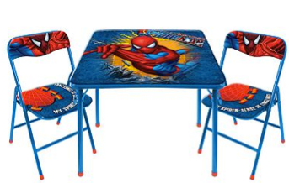
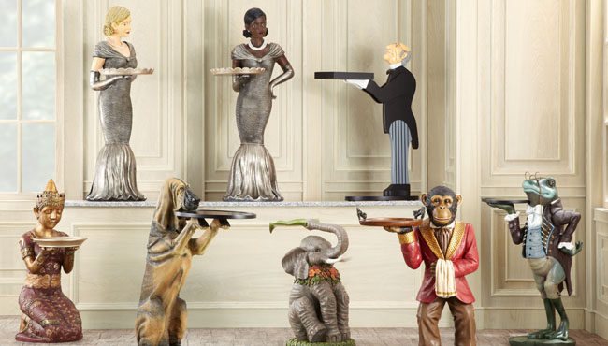
Review
Character table structure
  Mulliken symbols
  Order
  Basis functions
Properties of Char. Tables
Driving the table
  From the rules
  From matrix math

Slide 3
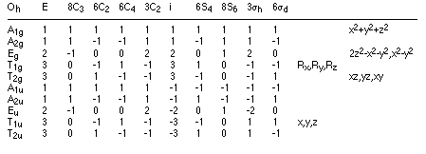
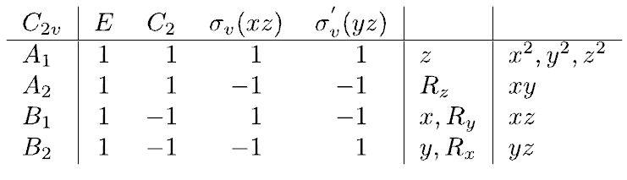
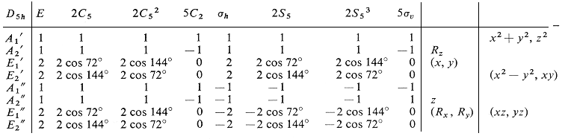
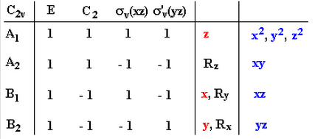
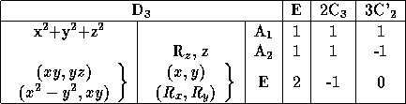
Character Table
Two-dimensional table compose of elements and irreducible representations of a point group.

Slide 4
Character Table
Group Symbol
Symmetry Elements
Irreducible Representations
Characters
Basis Functions

Slide 5
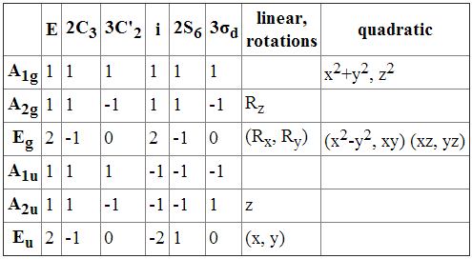
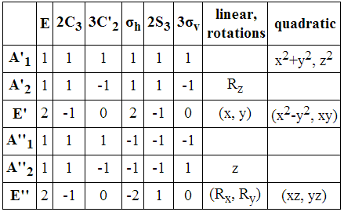
Mulliken Symbols
A or B: singly degenerate
E: doubly degenerate
T: triply degenerate
A: symmetric (+) with respect to C_{n}
B: anti-symmetric (-) with respect to C_{n}
subscript g: symmetric (+) with respect to i
subscript g: anti-symmetric (-) with respect to i
subscript 1: symmetric (+) with respect to ⊥C₂ or σ_{v}
subscript 2: anti-symmetric (-) with respect to ⊥C₂ or σ_{v}
superscript ‘ : symmetric (+) under σ_{h} (if no i)
superscript “: anti-symmetric (-) under σ_{h} (if no i)
  Don’t mistake the operation E for the Mulliken symbol E!

Slide 6
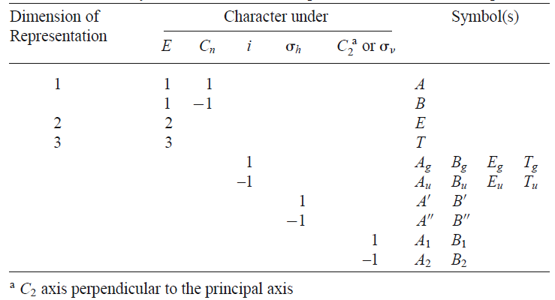
Mulliken Symbols
  Don’t mistake the operation E for the Mulliken symbol E!

Slide 7
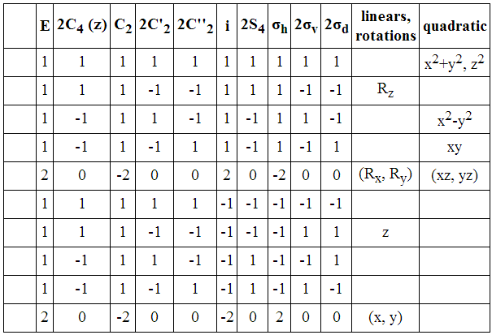
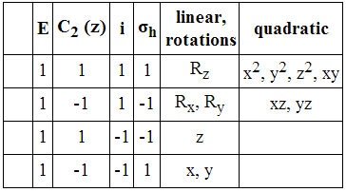
Mulliken Symbols
⊥C₂
D_{4h}
C_{2h}

Slide 8
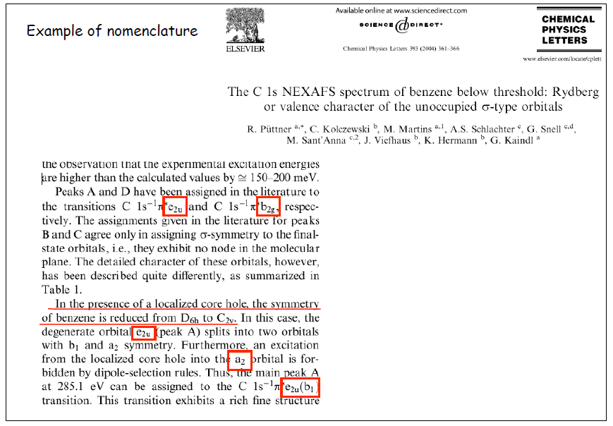
Mulliken Symbols

Slide 9
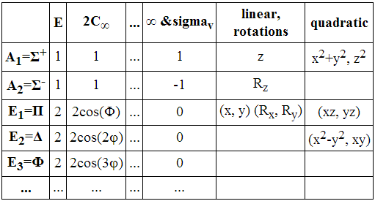
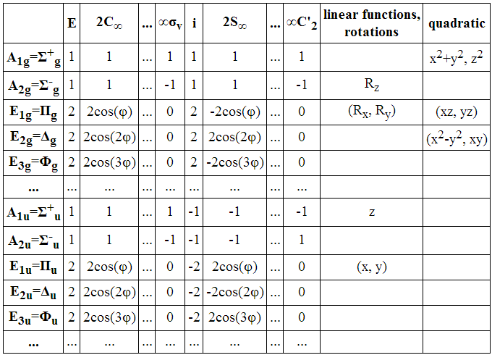
Infinity Character Tables
Infinity tables us Greek rather than Latin letters.
C_{∞v}
D_{∞h}

Slide 10
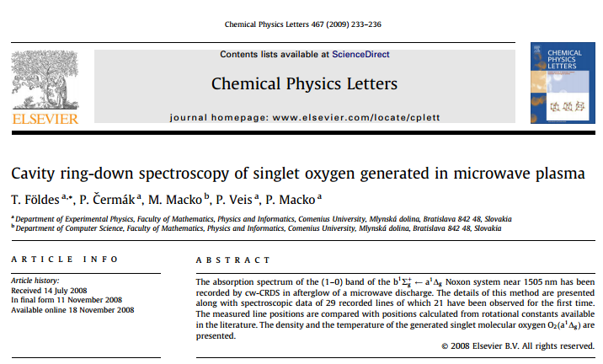
Infinity Character Tables

Slide 11
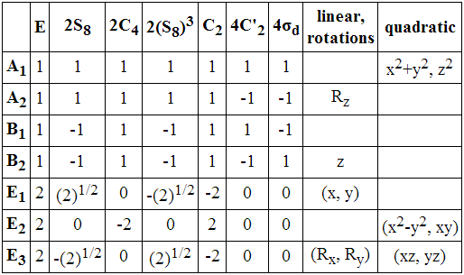
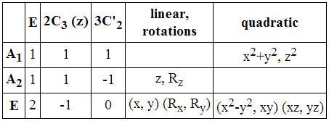
Order (h)
Order of a group (h) = the number of elements in the group
Symmetry Elements
order (h)
h = 1 + 1 + 1 + 1 = 4
D₃
h = 1 + 2 + 2 + 2 + 1 + 4 + 4 = 16
h = 1 + 2 + 3 = 6
Infinite groups (C_{∞v} , D_{∞h} ) have a infinite order.

Slide 12
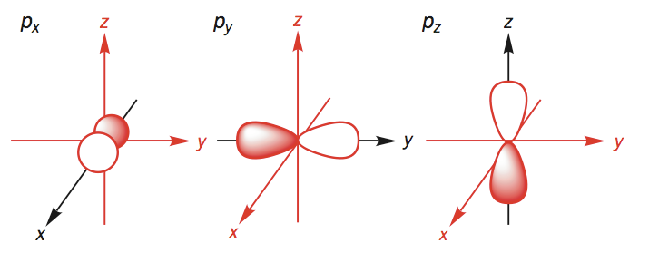
Basis Functions
Basis Functions
linear functions, rotations
quadratic functions
In the C_{2v} point group
p_{x} has B₁ symmetry
p_{x} transforms as B₁
p_{x} has the same symmetry as B₁
p_{x} forms a basis for the B₁ irrep
B₁
B₂
A₁

Slide 13
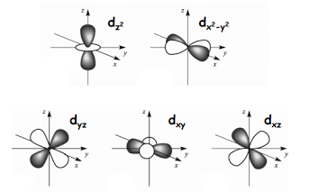

Basis Functions
Basis Functions
linear functions, rotations
quadratic functions
A₁
A₁
d_{xz}:
B: Anti symmetric with respect to C_{n}
sub 1: symmetric with respect to σ_{v}
B₂
A₂
B₁

Slide 14
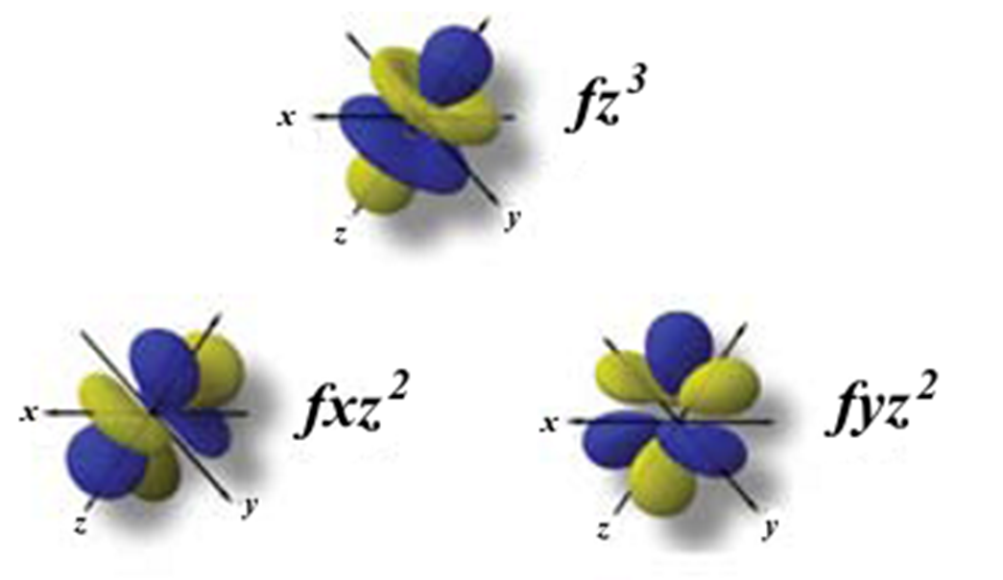
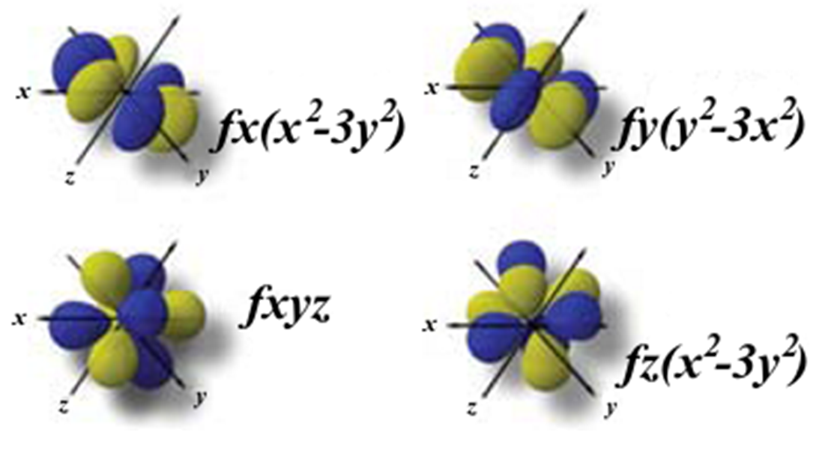
Basis Functions
linear functions
quadratic functions
cubic
functions
Lanthanide and Actinide coordination chemistry.

Slide 15
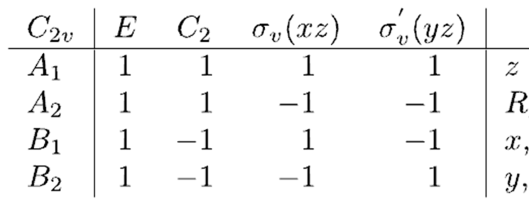
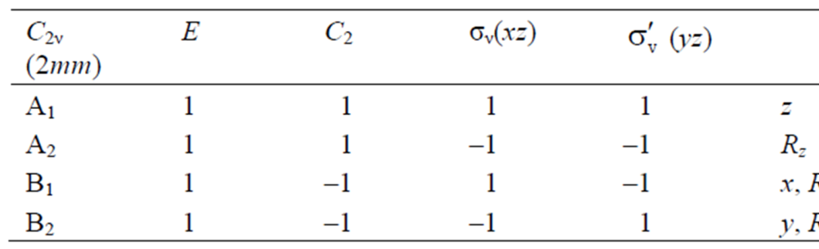
Character Table
Group Symbol
Schönflies symbols
Hermann-Mauguin Symbol
For the 32 crystallographic point groups.

Slide 16
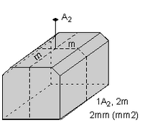
Character Table
Hermann-Mauguin Symbol
For the 32 crystallographic groups
Rhombic-dipyramidal class
one 2-fold axis and 2 mirror planes
2 m m

Slide 17
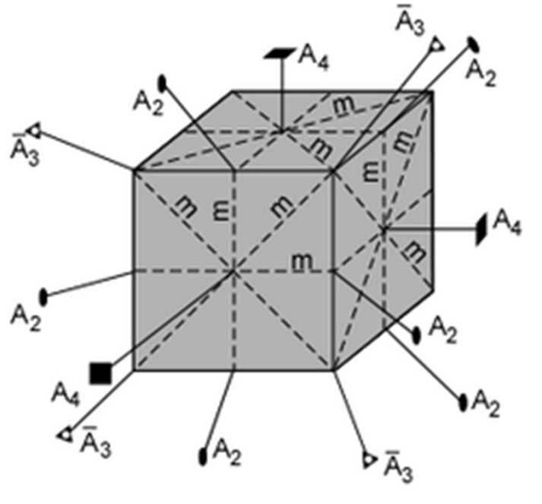

Character Table
Hermann-Mauguin Symbol
4 fold axis, 3-fold rotoinversion axes, and two sets of mirror planes
σ that are ⊥ to the 4 fold axes
σ that are ⊥ to the 2 fold axes
3-fold rotoinversion axis

Slide 18
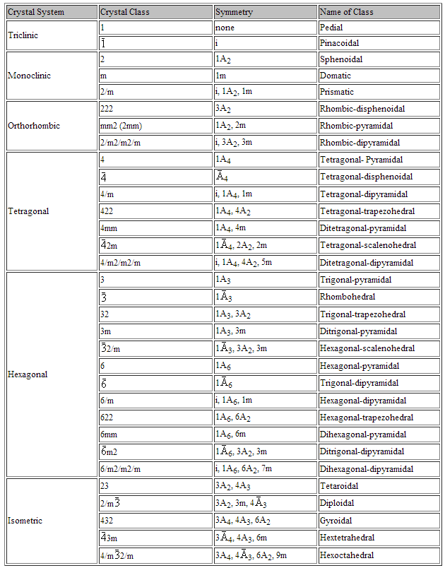
Character Table
Hermann-Mauguin Symbol
32 crystallographic classes

Slide 19
Character Table
Group Symbol
Symmetry Elements
Irreducible Representations
Characters
Basis Functions

Slide 20
Properties of the Character Table
1. The characters of all matrices belonging to the operations in the same class are identical in a given irreducible representation.
2. The number of irreducible representations in a group is equal to the number of classes of that group.
3. There is always a totally symmetric representation for any group.
4. The sum of the squares of the dimensionality of all the irreducible representations is equal to the order of the group.
5. The sum of the squares of the characters multiplied by the number of operations in the class equals the order of the group.
6. The sum of the products of the corresponding characters of any two different irreducible representations of the same group is zero.

Slide 21
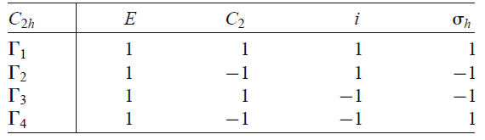
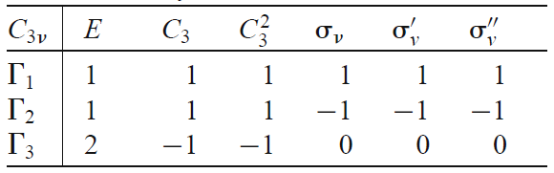
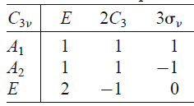
Properties of the Character Table
1. The characters of all matrices belonging to the operations in the same class are identical in a given irreducible representation.
No similar operations.
Each operation in its own class.
Rotational Class
Reflection Class
Rotational Class
Reflection Class

Slide 22
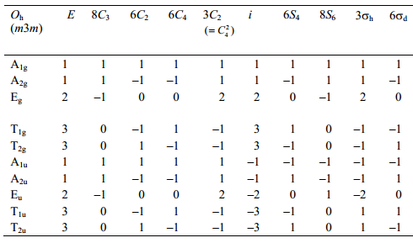
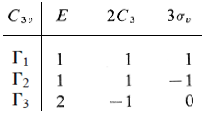
Properties of the Character Table
2. The number of irreducible representations in a group is equal to the number of classes of that group.
4 x 4 table
10 x 10 table
3 x 3 table

Slide 23
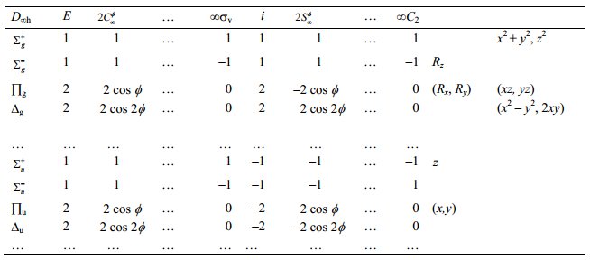
Properties of the Character Table
3. There is always a totally symmetric representation for any group.
A, A₁, A_{1g}, A_{g}, A’, A’₁, (Σ⁺, Σ_{g}⁺ for infinity groups)

Slide 24

Properties of the Character Table
4. The sum of the squares of the dimensionality of all the irreducible representations is equal to the order of the group.
order (h)
h = 1 + 1 + 1 + 1 = 4
dimensionality = character under E
1² + 1² + 1² + 1² = 4
h = 1 + 2 + 3 = 6
1² + 1² + 2² = 6
χ(E) = characters under E

Slide 25

Properties of the Character Table
5. The sum of the squares of the characters multiplied by the number of operations in the class equals the order of the group.
Order = 1 + 1 + 1 + 1 = 4
(1)²(1) + (-1)²(1) + (-1)²(1) + (1)²(1) = 4
Order = 1 + 2 + 3 = 6
(1)²(1) + (1)²(2) + (1)²(3)= 6
(2)²(1) + (-1)²(2) + (0)²(3)= 6
(R)= characters under an operation
g_{c} = the number of operations in a class

Slide 26

Properties of the Character Table
6. The sum of the products of the corresponding characters of any two different irreducible representations of the same group is zero.
(1)(1)(1) + (-1)(-1)(1) + (-1)(1)(1) + (1)(-1)(1) = 0
(1)(1)(1) + (1)(1)(2) + (-1)(1)(3) = 0
(2)(1)(1) + (-1)(1)(2) + (0)(-1)(3) = 0
_{i}(R)= characters for irreducible representation i
g_{c} = the number of operations in a class
Irreducible representations are orthoganal to each other.

Slide 27
Properties of the Character Table
1. The characters of all matrices belonging to the operations in the same class are identical in a given irreducible representation.
2. The number of irreducible representations in a group is equal to the number of classes of that group.
3. There is always a totally symmetric representation for any group.
4. The sum of the squares of the dimensionality of all the irreducible representations is equal to the order of the group.
5. The sum of the squares of the characters multiplied by the number of operations in the class equals the order of the group.
6. The sum of the products of the corresponding characters of any two different irreducible representations of the same group is zero.

Slide 28
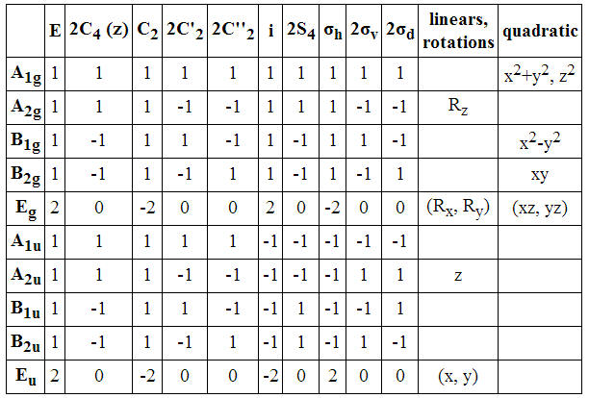
Example Table
1. Classes are grouped.
2. The table is square.
3. There is always a Γ = 1 representation.
D_{4h}
4. The sum of the squares under E = order of the group.
5. The sum of the squares x # of operations = order of the group.
6. Irreducible reps are orthoganal Σ(Γ₁ x Γ₂ x opperation) = 0

Slide 29
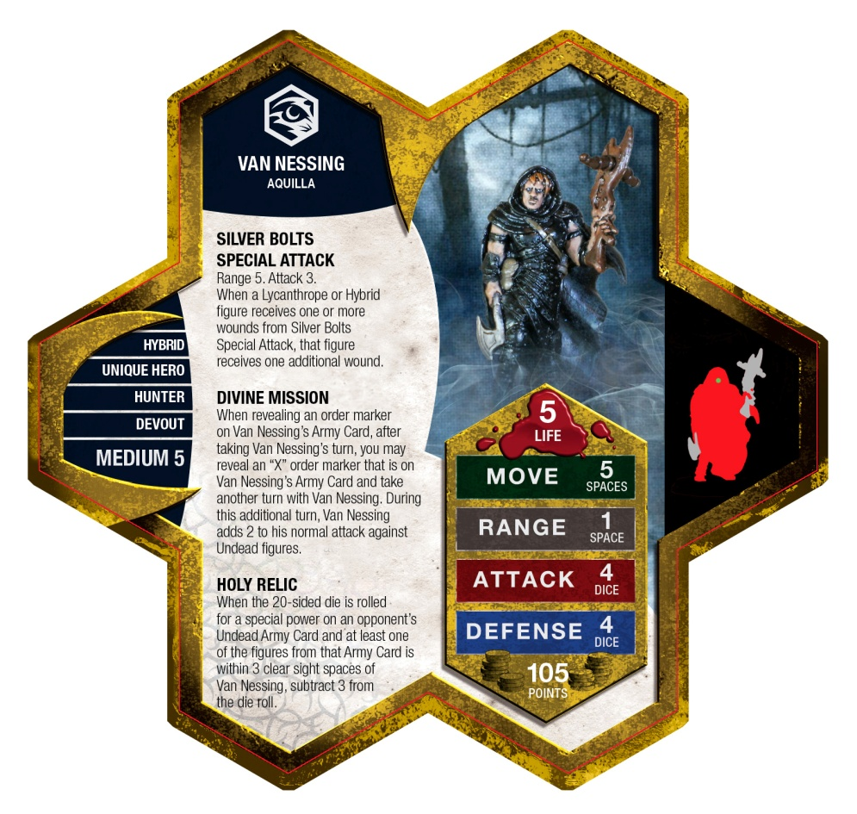
Derive the character table
Open an inorganic text book or google
  Easy Mode
From the rules/inspection
  Heroic Mode
From matrix math
  Legendary Mode

Slide 30

From the Rules: C_{2v}
Classes are grouped.
  -no groups for C_{2v}
Operations: E, C₂, σ, σ'

Slide 31
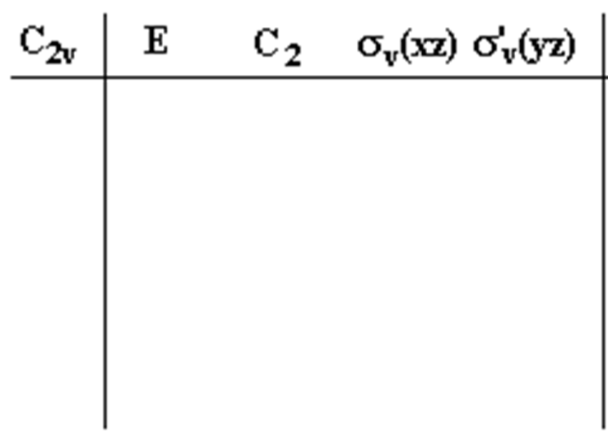

From the Rules: C_{2v}
Classes are grouped.
  -no groups for C_{2v}
Operations: E, C₂, σ, σ'
h = 1 + 1 + 1 + 1 = 4
The table is square.
  -4 x 4 table
Γ 1
There is always a Γ = 1 representation.
  -Easiest step
Γ 2
d₂
Γ 3
d₃
The sum of the squares under E = order of the group.
  - Algebra
Γ 4
d₄
(1)² + d₂² + d₃² + d₄² = h = 4
d₂ = d₃ = d₄ = 1 or -1
Under E always positive.

Slide 32

From the Rules: C_{2v}
Classes are grouped.
  -no groups for C_{2v}
Operations: E, C₂, σ, σ'
h = 1 + 1 + 1 + 1 = 4
The table is square.
  -4 x 4 table
Γ 1
There is always a Γ = 1 representation.
  -Easiest step
Γ 2
e₂
e₃
e₄
Γ 3
The sum of the squares under E = order of the group.
  - Algebra
Γ 4
1(1)² + 1(e₂)² + 1(e₃)² + 1(e₄)² = h = 4
The sum of the squares times # of operations = order of the group.
  - Algebra
e₂ = e₃ = e₄ = 1 or -1

Slide 33
From the Rules: C_{2v}
Classes are grouped.
  -no groups for C_{2v}
Operations: E, C₂, σ, σ'
The table is square.
  -4 x 4 table
Γ 1
There is always a Γ = 1 representation.
  -Easiest step
Γ 2
e₂
e₃
e₄
Γ 3
The sum of the squares under E = order of the group.
  - Algebra
Γ 4
e₂ = e₃ = e₄ = 1 or -1
The sum of the squares times # of operations = order of the group.
  - Algebra
1(1)(1) + 1(1)(e₂) + 1(1)(e₃) + 1(1)(e₄) = 0
(1) + (e₂) + (e₃) + (e₄) = 0
e₂ = e₃ = e₄ = two -1 and one 1
6. Irreducible reps are orthoganal Σ(Γ₁ x Γ₂ x opperation) = 0

Slide 34

From the Rules: C_{2v}
Classes are grouped.
  -no groups for C_{2v}
Operations: E, C₂, σ, σ'
The table is square.
  -4 x 4 table
Γ 1
There is always a Γ = 1 representation.
  -Easiest step
Γ 2
Γ 3
The sum of the squares under E = order of the group.
  - Algebra
Γ 4
e₂ = e₃ = e₄ = 1 or -1
The sum of the squares times # of operations = order of the group.
  - Algebra
1(1)(1) + 1(1)(e₂) + 1(1)(e₃) + 1(1)(e₄) = 0
(1) + (e₂) + (e₃) + (e₄) = 0
e₂ = e₃ = e₄ = two -1 and one 1
6. Irreducible reps are orthoganal Σ(Γ₁ x Γ₂ x opperation) = 0

Slide 35
From the Rules: C_{2v}
Classes are grouped.
  -no groups for C_{2v}
Operations: E, C₂, σ, σ'
The table is square.
  -4 x 4 table
Γ 1
There is always a Γ = 1 representation.
  -Easiest step
Γ 2
Γ 3
The sum of the squares under E = order of the group.
  - Algebra
Γ 4
e₂ = e₃ = e₄ = 1 or -1
The sum of the squares times # of operations = order of the group.
  - Algebra
1(1)(1) + 1(1)(e₂) + 1(-1)(e₃) + 1(-1)(e₄) = 0
(1) + (e₂) + -(e₃) + -(e₄) = 0
e₂ = -1
e₃ = 1, e₄ = -1
6. Irreducible reps are orthoganal Σ(Γ₁ x Γ₂ x opperation) = 0
or
e₃ = -1, e₄ = 1

Slide 36
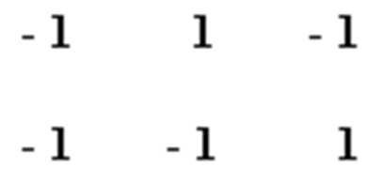
From the Rules: C_{2v}
Classes are grouped.
  -no groups for C_{2v}
Operations: E, C₂, σ, σ'
The table is square.
  -4 x 4 table
Γ 1
There is always a Γ = 1 representation.
  -Easiest step
Γ 2
Γ 3
The sum of the squares under E = order of the group.
  - Algebra
Γ 4
e₂ = e₃ = e₄ = 1 or -1
The sum of the squares times # of operations = order of the group.
  - Algebra
1(1)(1) + 1(1)(e₂) + 1(-1)(e₃) + 1(-1)(e₄) = 0
(1) + (e₂) + -(e₃) + -(e₄) = 0
e₂ = -1
e₃ = 1, e₄ = -1
6. Irreducible reps are orthoganal Σ(Γ₁ x Γ₂ x opperation) = 0
or
e₃ = -1, e₄ = 1

Slide 37
From the Rules: C_{2v}
Classes are grouped.
  -no groups for C_{2v}
Operations: E, C₂, σ, σ'
The table is square.
  -4 x 4 table
Γ 1
There is always a Γ = 1 representation.
  -Easiest step
Γ 2
Γ 3
The sum of the squares under E = order of the group.
  - Algebra
Γ 4
The sum of the squares times # of operations = order of the group.
  - Algebra
6. Irreducible reps are orthoganal Σ(Γ₁ x Γ₂ x opperation) = 0

Slide 38
From the Rules: C_{2v}
?
Γ2
Γ3
Γ4

Slide 39
From the Rules: C_{2v}
Α₁
Γ1 = A₁
Γ2
Γ3
Γ4

Slide 40
From the Rules: C_{2v}
Α₁
?
Γ3
Γ4

Slide 41
From the Rules: C_{2v}
Α₁
Α₂
?
?

Slide 42
From the Rules: C_{2v}
Α₁
Α₂
Β₁
Β₂

Slide 43
From the Rules: C_{3v}
Classes are grouped.
Α₁
The table is square.
Α₂
There is always a Γ = 1 representation.
Β₁
Β₂
The sum of the squares under E = order of the group.
The sum of the squares times # of operations = order of the group.
6. Irreducible reps are orthoganal Σ(Γ₁ x Γ₂ x opperation) = 0

Slide 44
From Matrix Math
Assign/pick a point group
Choose basis function
Apply operations
Generate a representation matrix
Apply similarity transformations
Generate an irreducible block diagonal matrix
Character of the irreducible blocks
Fill in the character table
Complete the table
Assign symmetry labels
Assign basis functions

Slide 45
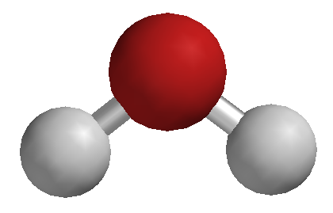
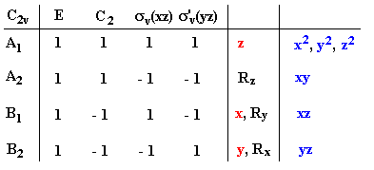
Example 1: H₂O (C_{2v})
Assign a point group
Steps 2-11
C_{2v}
Character Table

Slide 46
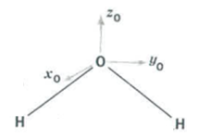
Example 1: H₂O (C_{2v})
2. Choose a basis function
Cartesian Coordinates of O

Slide 47
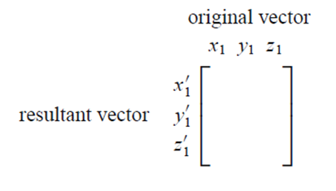





Example 1: H₂O (C_{2v})
3. Apply operations
E, C₂, σ_{xz}, σ_{yz}
4. Generate a representation matrix
E =
C₂ =
σ_{xz} =
σ_{yz} =

Slide 48
Example 1: H₂O (C_{2v})
5. Apply similarity transformations
6. Generate an irreducible block diagonal matrix
E =
C₂ =
σ_{xz} =
σ_{yz} =
Block diagonal and single number.
These representations cannot be reduced any further.

Slide 49


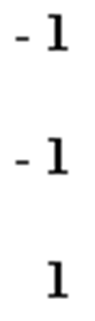


Example 1: H₂O (C_{2v})
7. Character of the irreducible blocks
8. Fill in the character table
E =
C₂ =
σ_{xz} =
σ_{yz} =

Slide 50
Example 1: H₂O (C_{2v})
9. Complete the table
Γ₁
Γ₂
Γ₃
Γ₄
x
Rule 2) The number of irreducible representations is equal to the number of classes in the group.
4 classes = 4 irreducible representations. Table must be 4 x 4!
Rule 4) The sum of the squares of the dimensions under E is equal to the order of the group.
Order = 4, Therefore 1² + 1² + 1² + x² = 4

Slide 51
Example 1: H₂O (C_{2v})
9. Complete the table
Γ₁
Γ₂
Γ₃
Γ₄
1
e₂
e₃
e₄
Rule 5) The sum of the squares times # of operations = order of the group.
1(1)² + 1(e₂)² + 1(e₃)² + 1(e₄)² = h = 4
e₂ = e₃ = e₄ = 1 or -1

Slide 52
Example 1: H₂O (C_{2v})
9. Complete the table
Γ₁
Γ₂
Γ₃
Γ₄
1
e₂
e₃
e₄
Rule 6) Irreducible reps are orthoganal Σ(Γ₁ x Γ₂ x opperation) = 0.
1(1)(1) + 1(-1)(e₂) + 1(1)(e₃) + 1(-1)(e₄) = 0
(1) - (e₂) + (e₃) - (e₄) = 0
e₂ = 1, e₃ = 1, e₄ = 1
or
e₂ = 1, e₃ = -1, e₄ = -1
or
e₂ = -1, e₃ = -1, e₄ = 1
Bonus rule: no two Γ can be the same.

Slide 53
Example 1: H₂O (C_{2v})
9. Complete the table
Γ₁
Γ₂
Γ₃
Γ₄
1
1
-1
-1
Rule 6) Irreducible reps are orthoganal Σ(Γ₁ x Γ₂ x opperation) = 0.
1(1)(1) + 1(-1)(e₂) + 1(1)(e₃) + 1(-1)(e₄) = 0
(1) - (e₂) + (e₃) - (e₄) = 0
e₂ = 1, e₃ = 1, e₄ = 1
or
e₂ = 1, e₃ = -1, e₄ = -1
or
e₂ = -1, e₃ = -1, e₄ = 1
Bonus rule: no two Γ can be the same.

Slide 54
Example 1: H₂O (C_{2v})
10. Assign symmetry labels
Symmetry Labels
1
1
-1
-1

Slide 55
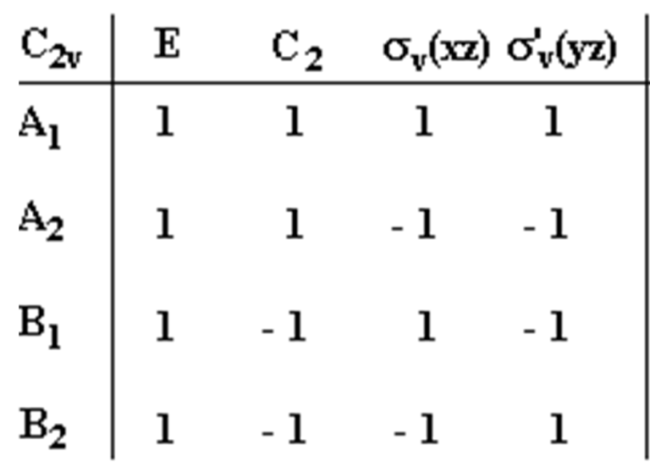




Example 1: H₂O (C_{2v})
10. Assign symmetry labels
Rearrange
1
1
-1
-1

Slide 56
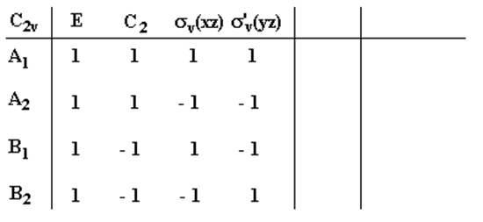
Example 1: H₂O (C_{2v})
11. Assign Basis Function
x, y, z, R_{x}, R_{y}, R_{z}
xy, xz, yz, x², y², z²

Slide 57
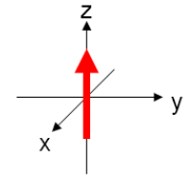
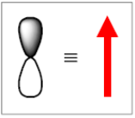
Example 1: H₂O (C_{2v})
11. Assign Basis Function
x, y, z, R_{x}, R_{y}, R_{z}
z
z
1
1
1
1
Start with z or p_{z}:
E
C₂
σ_{xz}
σ_{yz}
If the orbital/vector stays the same = 1
If the sign/arrow direction flips = -1

Slide 58
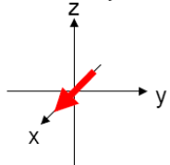

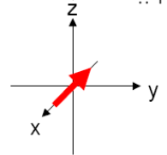
Example 1: H₂O (C_{2v})
11. Assign Basis Function
x, y, R_{x}, R_{y}, R_{z}
z
x
x
1
-1
1
-1
x or p_{x}:
E, σ_{xz}
C₂, σ_{yz}

Slide 59
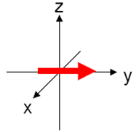

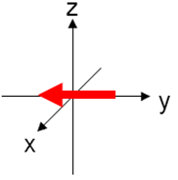
Example 1: H₂O (C_{2v})
11. Assign Basis Function
y, R_{x}, R_{y}, R_{z}
z
x
y
y
1
-1
-1
1
y or p_{y}:
E, σ_{yz}
C₂, σ_{xz}

Slide 60
Example 1: H₂O (C_{2v})
11. Assign Basis Function
R_{x}, R_{y}, R_{z}
z
R_{z}
x
y
R_{z}
1
1
-1
-1
R_{z}:
E, C₂
σ_{yz}, σ_{xz}
Rotation direction unchanged = 1
Rotation direction flips = -1

Slide 61
Example 1: H₂O (C_{2v})
11. Assign Basis Function
R_{x}, R_{y}
z
R_{z}
x
, R_{x}
y
R_{x}
1
-1
-1
1
R_{x}:
E, σ_{yz}
C₂, σ_{xz}
Rotation direction unchanged = 1
Rotation direction flips = -1

Slide 62
Example 1: H₂O (C_{2v})
11. Assign Basis Function
R_{y}
z
R_{z}
x
, R_{y}
, R_{x}
y
R_{y}
1
-1
1
-1
R_{y}:
E, σ_{xz}
C₂, σ_{yz}
Rotation direction unchanged = 1
Rotation direction flips = -1

Slide 63
Example 1: H₂O (C_{2v})
11. Assign Basis Function
z
R_{z}
xy, xz, yz, x², y², z²
x
, R_{y}
, R_{x}
yz
y
yz
1
-1
-1
1
yz or d_{yz}:
E, σ_{yz}
C₂, σ_{xz}
If the orbital is unchanged = 1
If the orbital sign flips = -1

Slide 64


Example 1: H₂O (C_{2v})
11. Assign Basis Function
z
x², y², z²
R_{z}
xy
x
xz
, R_{y}
, R_{x}
yz
y
xz or d_{xz}:
xy or d_{xy}:
s orbital (x², y², z²):
B₁
A₂
A₁

Slide 65
C_{2v} Char. Table from Matrix Math
Assign/pick a point group
Choose basis function
Apply operations
Generate a representation matrix
Apply similarity transformations
Generate an irreducible block diagonal matrix
Character of the irreducible blocks
Fill in the character table
Complete the table
Assign symmetry labels
Assign basis functions
C_{2v}
z
x², y², z²
R_{z}
xy
x
xz
, R_{y}
, R_{x}
yz
y

Slide 66


Example 2: NH₃ (C_{3v})
Assign a point group
Steps 2-11
C_{3v}
Character Table

Slide 67

Example 2: NH₃ (C_{3v})
2. Choose a basis function
A
C
B
Hydrogen Atoms (A, B, C)

Slide 68



Example 2: NH₃ (C_{3v})
3. Apply operations
E, C₃, C₃², σ_{v}, σ_{v}’, σ_{v}”
4. Generate a representation matrix
Starting Position
A B C
A’
C₃
Ending Position
B’
C’
C₃ Representation Matrix

Slide 69






Example 2: NH₃ (C_{3v})
3. Apply operations
E, C₃, C₃², σ_{v}, σ_{v}’, σ_{v}”
4. Generate a representation matrix
E
σ_{v}
C₃
σ_{v}’
C₃²
σ_{v}’’

Slide 70
Example 2: NH₃ (C_{3v})
5. Apply similarity transformations
6. Generate an irreducible block diagonal matrix
Irreducible Matrix
Reducible Matrices
σ_{v}
E
C₃
σ_{v}’
C₃²
Matrix must be reduced down to either blocks of 1x1 matrices or a matrix that cannot be reduced further.
σ_{v}’’

Slide 71


Example 2: NH₃ (C_{3v})
5. Apply similarity transformations
ν⁻¹ • A • ν = A’
A is a matrix representation for some type of symmetry operation
ν is a similarity transform operator
ν⁻¹ is the transpose of the similarity transform operator
A’ is the product matrix
A
A’
ν⁻¹ •
• ν
=
non-block diagonal
block diagonal

Slide 72


Example 2: NH₃ (C_{3v})
5. Apply similarity transformations
ν⁻¹ • A • ν = A’
A_{C3} =

Slide 73



Example 2: NH₃ (C_{3v})
5. Apply similarity transformations
ν⁻¹ • A • ν = A’
A’
A₁
A₂
Irreducible Matrix!
ν₂⁻¹ • A₂ • ν₂ = A₂
Notes:
important to note: in terms of symmetry A and A’ are the same. Just different forms of the same thing.

Slide 74








Example 2: NH₃ (C_{3v})
5. Apply similarity transformations
ν⁻¹ • A • ν = A’

Slide 75






Example 2: NH₃ (C_{3v})
5. Apply similarity transformations
6. Generate an irreducible block diagonal matrix
E
σ_{v}
Irreducible Matrices
C₃
σ_{v}’
Block Diagonal Matrices
C₃²
σ_{v}’’

Slide 76


Example 2: NH₃ (C_{3v})
7. Character of the irreducible blocks
1
1
1
E
C₃²
σ_{v}
0
2
-1
1
1
1
C₃
σ_{v}’’
σ_{v}’
-1
0
0
8. Fill in the character table
Group Similar Classes
(C₃, C₃²)
(σ_{v}, σ_{v}’, σ_{v}”)
gamma = general label for a rep.

Slide 77

Example 2: NH₃ (C_{3v})
9. Complete the table
Γ₁
1
1
1
Γ₂
2
-1
0
Γ₃
x
Rule 2) The number of irreducible representations is equal to the number of classes in the group.
3 classes = 3 irreducible representations. Table must be 3 x 3!
Rule 4) The sum of the squares of the dimensions under E is equal to the order of the group.
Order = 6, Therefore 1² + 2² + x² = 6
Notes:
Could pick another basis to find ro 3

Slide 78
Example 2: NH₃ (C_{3v})
9. Complete the table
Γ₁
1
1
1
Γ₂
2
-1
0
Γ₃
1
e₂
e₃
Rule 5) The sum of the squares times # of operations = order of the group.
1(1)² + 2(e₂)² + 3(e₃)² = h = 6
e₂ = e₃ = 1 or -1
Notes:
Could pick another basis to find ro 3

Slide 79
Example 2: NH₃ (C_{3v})
9. Complete the table
Γ₁
1
1
1
Γ₂
2
-1
0
Γ₃
1
e₂
e₃
Rule 6) Irreducible reps are orthoganal Σ(Γ₁ x Γ₂ x opperation) = 0.
1(1)(1) + 2(1)(e₂) + 3(1)(e₃) = 0
1 + 2e₂ + 3e₃ = 0
e₂ = 1, e₃ = -1
Notes:
Could pick another basis to find ro 3

Slide 80
Example 2: NH₃ (C_{3v})
9. Complete the table
Γ₁
1
1
1
Γ₂
2
-1
0
Γ₃
1
e₂
e₃
Rule 6) Irreducible reps are orthoganal Σ(Γ₁ x Γ₂ x opperation) = 0.
1(1)(1) + 2(1)(e₂) + 3(1)(e₃) = 0
1 + 2e₂ + 3e₃ = 0
e₂ = 1, e₃ = -1
Notes:
Could pick another basis to find ro 3

Slide 81
Example 2: NH₃ (C_{3v})
10. Assign symmetry labels
Γ₁
1
1
1
Γ₂
2
-1
0
Γ₃
1
1
-1
Symmetry Labels
Notes:
Could pick another basis to find ro 3

Slide 82

Example 2: NH₃ (C_{3v})
10. Assign symmetry labels
A₁
1
1
1
E
2
-1
0
A₂
1
1
-1
Rearrange
Notes:
Could pick another basis to find ro 3

Slide 83
Example 2: NH₃ (C_{3v})
11. Assign Basis Function
xy, xz, yz,
z², x²-y²
x, y, z, R_{x}, R_{y}, R_{z}

Slide 84



Example 2: NH₃ (C_{3v})
11. Assign Basis Function
z, R_{z}

Slide 85


Example 2: NH₃ (C_{3v})
11. Assign Basis Function
x, y, R_{x}, R_{y}
p_{y}
p_{x}
p_{x} and p_{y} are neither symmetric nor antisymmetric with respect to the C₃ operations, but rather go into linear combinations of one another and must therefore be considered together as components of a 2 dimensional representation.

Slide 86

Example 2: NH₃ (C_{3v})
11. Assign Basis Function
xy, xz, yz,
z², x²-y²

Slide 87
Example 2: NH₃ (C_{3v})
11. Assign Basis Function

Slide 88
From Matrix Math
Assign/pick a point group
Choose basis function
Apply operations
Generate a representation matrix
Apply similarity transformations
Generate an irreducible block diagonal matrix
Character of the irreducible blocks
Fill in the character table
Complete the table
Assign symmetry labels
Assign basis functions

Slide 89
Outline
Character table structure
  Mulliken symbols
  Order
  Basis functions
Properties of Char. Tables
Driving the table
  From the rules
  From matrix math

